Slide 1
Making Contact:
Establishing Connections with Underserved Populations
Presentation by:
Connie Ronald and Jennifer Thum

Slide 2
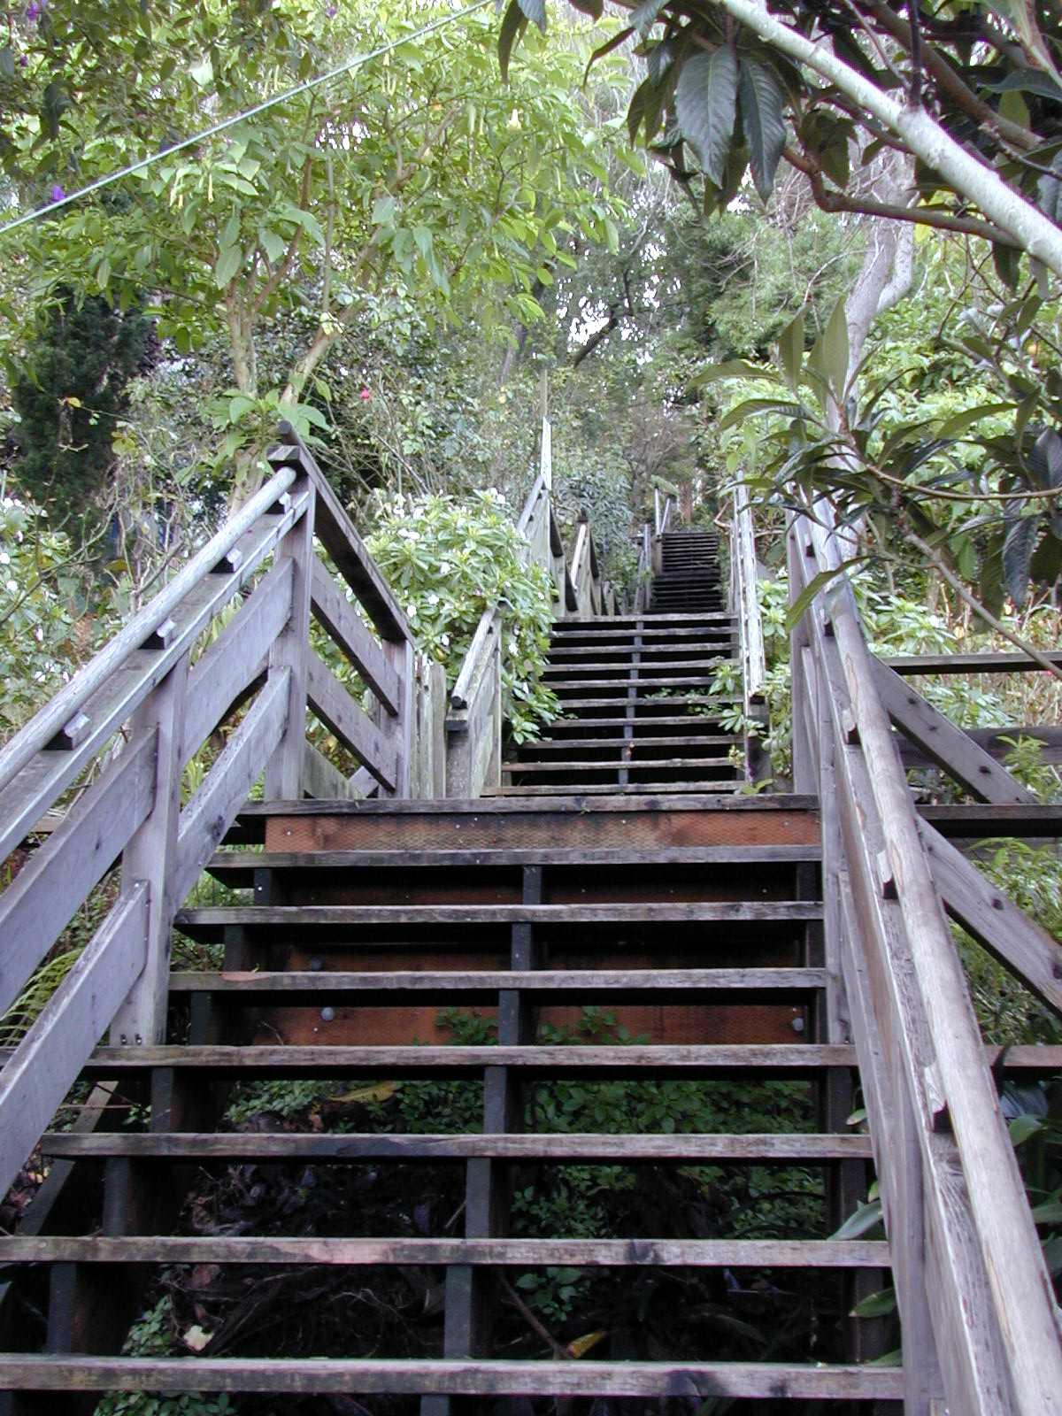
Steps To Take
Identify the target
Who is not being reached?
Why not?
How can we make contact?

Slide 3
Steps To Take
Once the target audience is identified:
What is the best way to reach this population?
Who can help us?
What information is needed?
  Is there a language concern?
  What education level are we dealing with?
  What supplies or aids are needed?

Slide 4

Potential Populations
Amish Communities
Burmese Populations
Hispanic Communities
Home Schoolers
Inner City Populations
Charter Schools
Faith-based Schools

Slide 5
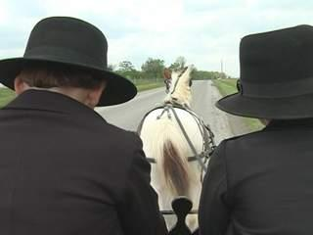
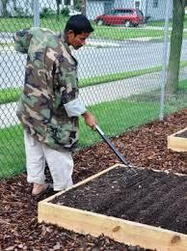

Narrowing it Down
Amish Communities
Burmese Population in Ft. Wayne
Hispanic Communities

Slide 6
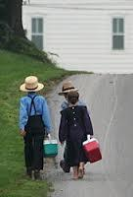
Amish Communities
Non-traditional farmers
  Fewer connections with SWCD, NRCS, government programs
Amish schools not connected to public school system
Cultural and lifestyle differences

Slide 7
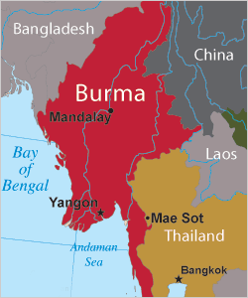
Burmese Community
Language barrier
Cultural differences
Urban population
  Not connected with
agricultural community

Slide 8
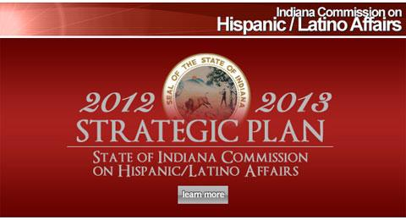
Hispanic Communities
Language barriers
Cultural differences
Urban or migrant populations
  Not connected with agricultural community

Slide 9
Amish Communities
Look for other connections:
  Bankers
  Employers
  Veterinarians
Need approval by individual bishops
Everyday contacts:
  Farriers
  Amish businesses
  Contractors

Slide 10
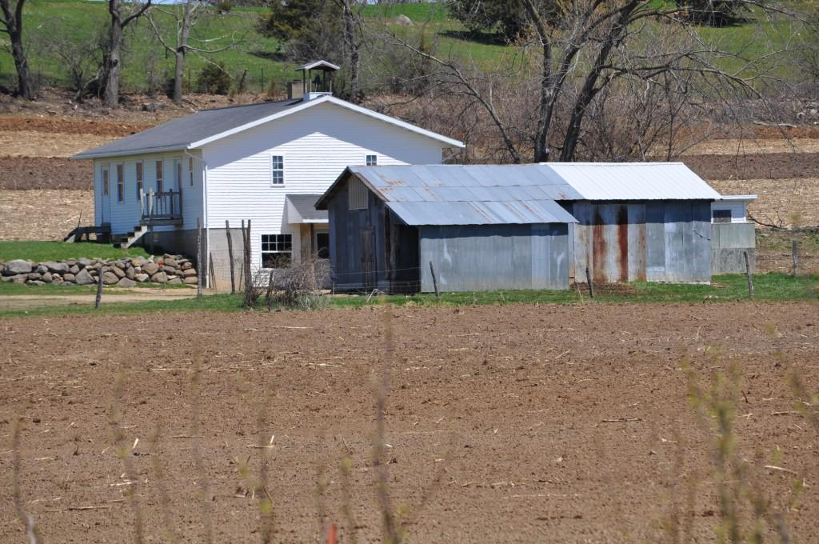
Amish School

Slide 11
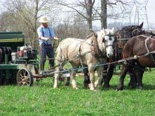
Field Days/ Pasture Walks

Slide 12
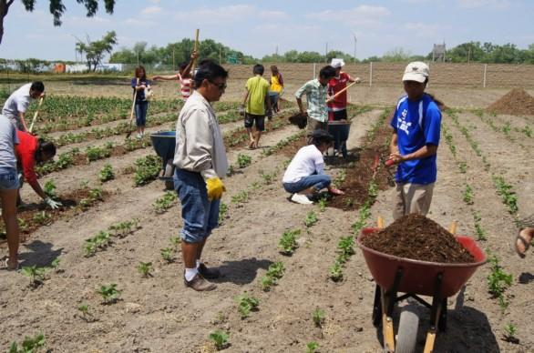
Burmese Community
Advocacy Groups
Catholic Charities
Personal Contacts

Slide 13
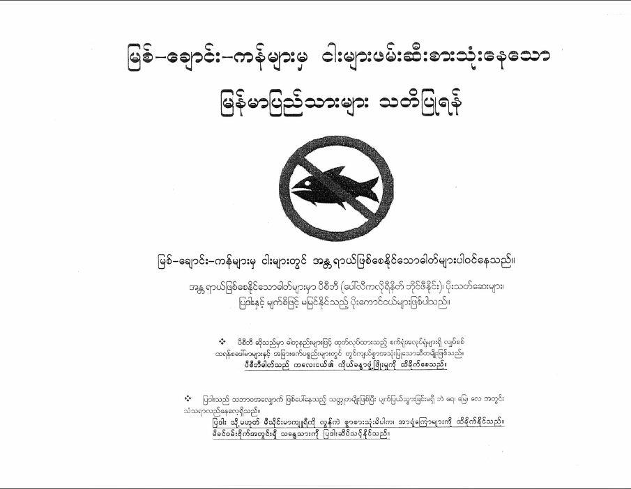
Fishing in our Waters

Slide 14
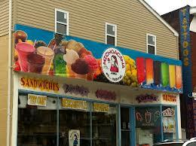
Hispanic Communities
Catholic Charities and Churches
Employers
Hispanic Chamber of Commerce
Migrant Schools
Advocacy Groups

Slide 15
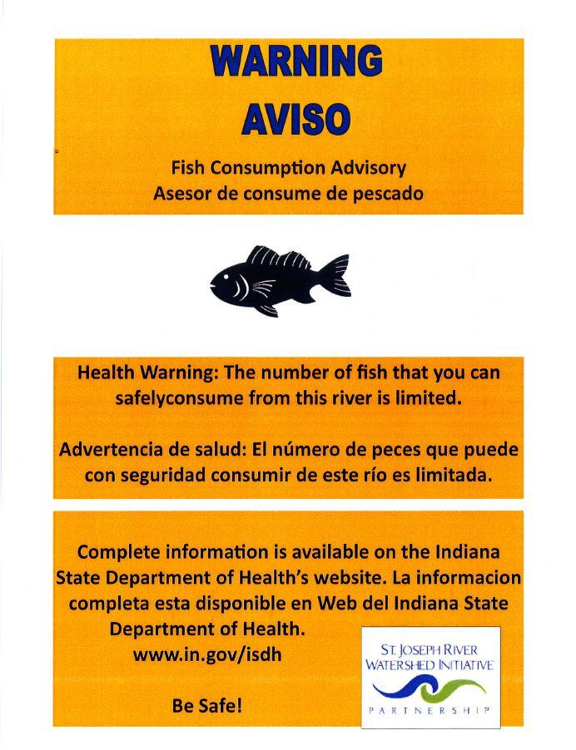
Fishing in our Waters

Slide 16
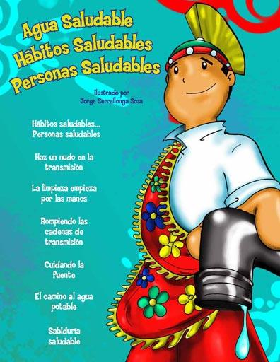
Education Curriculums
Project Wet
Where My River Runs
Stormwater Activity Workbooks

Slide 17
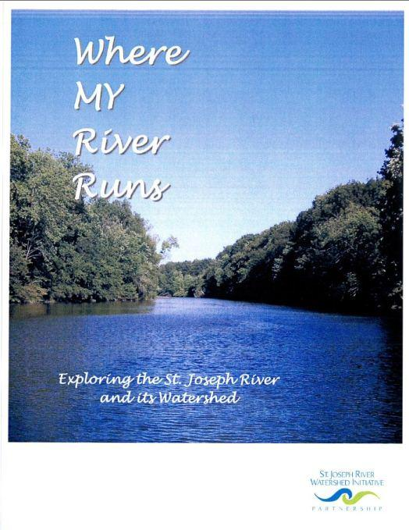
Where My River Runs

Slide 18

Conclusion
Amish Populations
Hispanic Communities
Burmese Population

